Slide 1

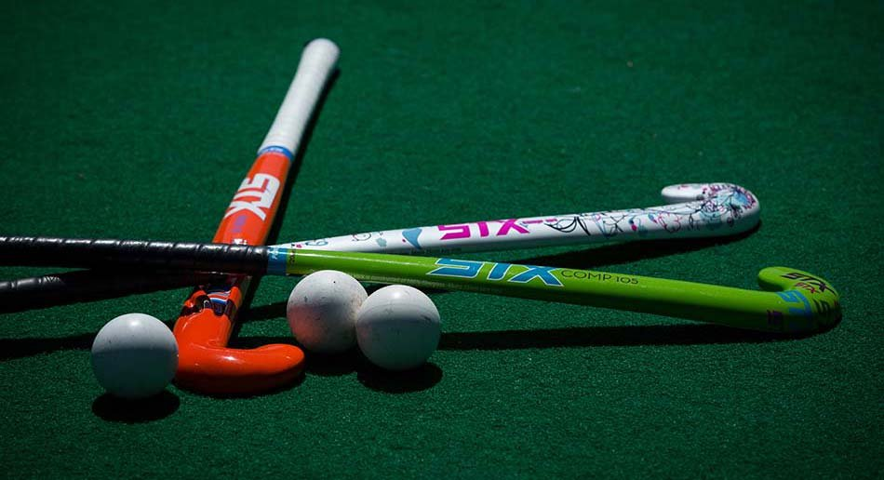
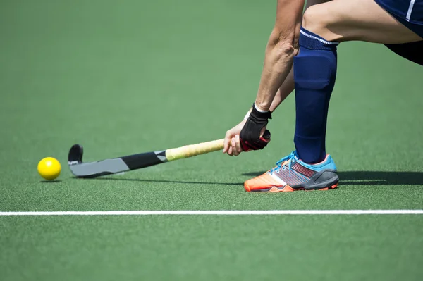
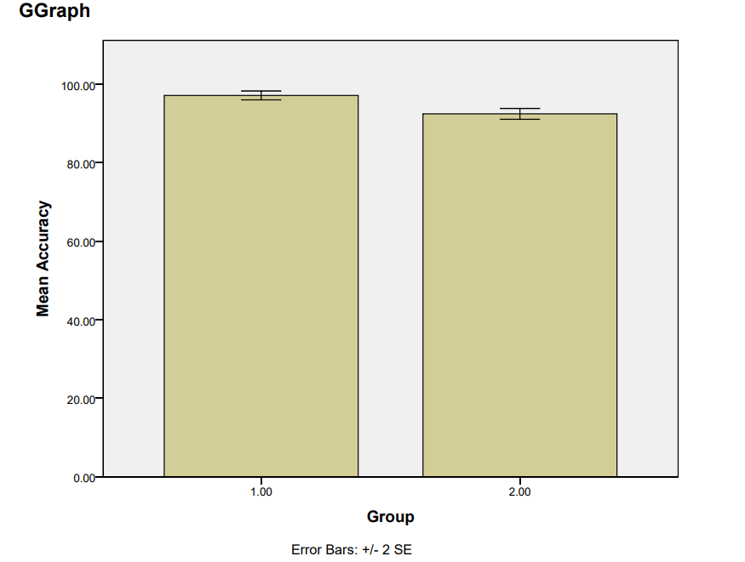
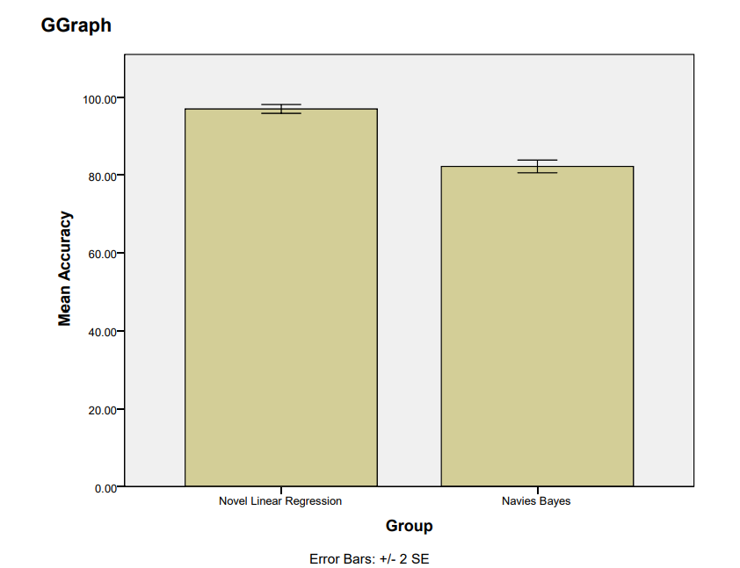

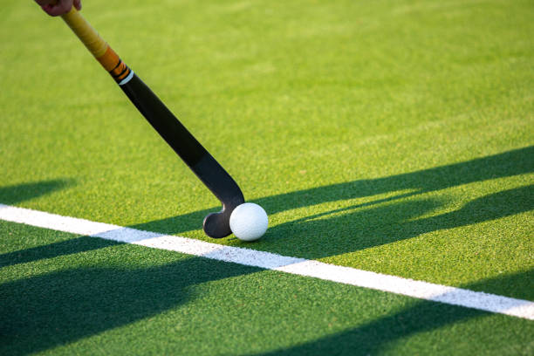
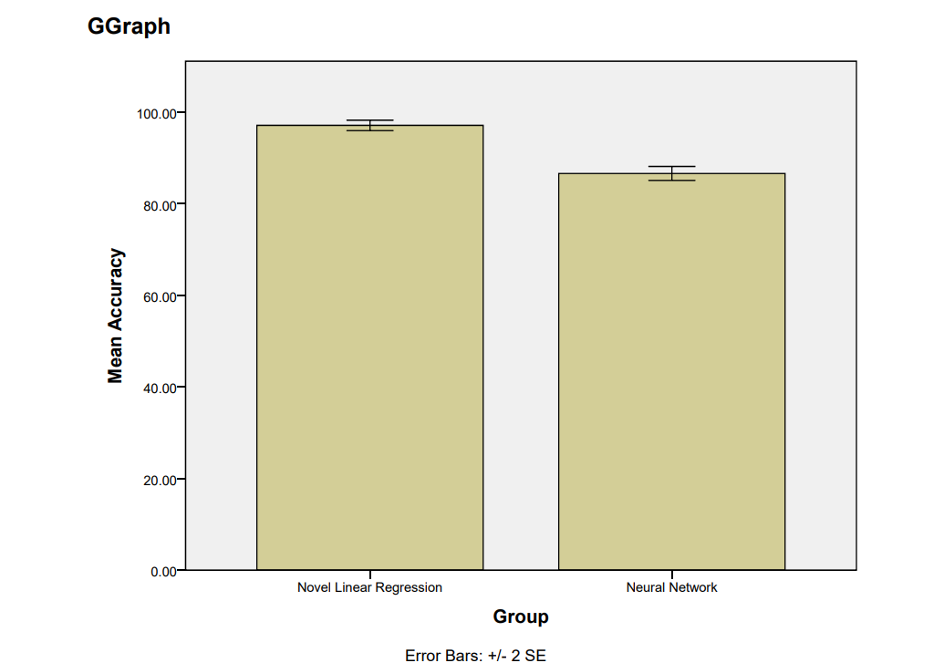
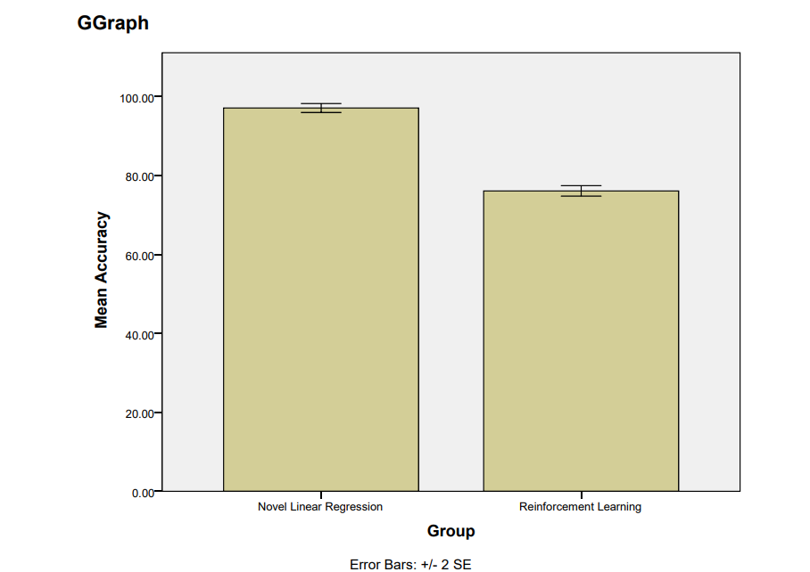
Register No: 192221118
Students Name: Syed Ibrahim S
Guided By: Dr Prakash Mathialagan
Enhancing the Accuracy in Predicting the Winning Team in National Hockey League (NHL) using Novel Linear Regression in Comparison with K-Nearest Neighbor(KNN) Algorithm
Enhancing the Accuracy in predicting the Winning Team in National Hockey League(NHL) using Novel Linear Regression in Comparison with Navies Bayes Algorithm
INTRODUCTION
INTRODUCTION
The prediction of NHL game outcomes is an emerging focus in sports analytics, aiming to assist teams, analysts, and fans with data-driven insights.
This study compares the performance of Novel Linear Regression and K-Nearest Neighbor (KNN) algorithms in predicting the winning team in NHL matches.
Results indicate that the Novel Linear Regression model provides higher prediction accuracy and better performance than KNN.
Predicting the winning team in the NHL involves analyzing complex variables like player performance, team statistics, and game dynamic.
Novel Linear Regression (NLR) and Naïve Bayes (NB) algorithms are compared to evaluate their performance in classification tasks.
Overall, NLR proved more accurate and reliable in predicting NHL match outcomes than Naïve Bayes.
Fig 1: Analysis of National Hockey League
Fig 1:Study of National Hockey League
MATERIALS AND METHODS
MATERIALS AND METHODS
The dataset used for this study was obtained from the Kaggle platform, focusing on National Hockey League (NHL) match statistics for predicting game outcomes.
The Novel Linear Regression (NLR) model achieved a prediction accuracy of 97%, effectively identifying key linear patterns in game data and The KNN model yielded a slightly lower accuracy of 92%
Based on the evaluation, NLR outperformed KNN in terms of predictive accuracy, making it a more reliable algorithm for NHL game outcome forecasting.
The dataset used for this study was sourced from the Kaggle platform, focusing on predicting the winning team in National Hockey League (NHL) matches.
IBM SPSS software was utilized to visualize and interpret the classification outcomes of both machine learning models.
The NLR model demonstrated higher predictive accuracy at 97%, outperforming the Naïve Bayes model, which achieved 82% accuracy.
Vs Support Vector Machine (SVM)
RESULTS
Table 1:Accuracy Values of NLR vs KNN
RESULTS
Table 1: Accuracy values of NLR vs NB
Accuracy | Group | N | Mean | STD Deviation | STD Error
 | NLR | 10 | 97.1000 | 1.79196 | .56667
 | KNN | 10 | 92.4000 | 2.17051 | .68638
Accuracy | Group | N | Mean | STD Deviation | STD Error
 | NLR | 10 | 97.1000 | 1.79196 | .56667
 | NB | 10 | 82.2000 | 2.57337 | .81377
Fig 2 : Novel Linear Regression Vs K Nearest Neighbor
NLR outperforms KNN in accuracy, making it the preferred model for NHL game predictions.
Fig 2 : Novel Linear Regression vs Naïve Bayes
NLR outperforms NB in accuracy, making it the preferred model for NHL prediction
DISCUSSION AND CONCLUSION
DISCUSSION AND CONCLUSION
Based on T-Test statistical analysis, the significance value of p = 0.001 (independent sample T-test, p < 0.05) indicates a statistically significant difference between the performance of Novel Linear Regression (NLR) and K-Nearest Neighbor (KNN).
Overall, the accuracy of the NLR algorithm is 97%, which is higher than the KNN algorithm, which achieved an accuracy of 92%.
Based on T-Test statistical analysis, the significance value of p = 0.001 (independent sample T-test, p < 0.05) indicates a statistically significant difference between the performance of NLR and Naïve Bayes in NHL prediction.
The NLR algorithm achieved an accuracy of 97%, clearly outperforming the NB model, which reached 82% accuracy.
Overall, NLR is more effective and reliable than Naïve Bayes for predicting NHL game results.
BIBLIOGRAPHY
BIBLIOGRAPHY
G. P. Nunes, F. Silva, and P. Ribeiro, “Predicting outcomes of NHL hockey games using machine learning,” Proc. IEEE Int. Conf. Big Data, pp. 5432–5438, 2023.
D. Cervone, A. D’Amour, L. Bornn, and K. Goldsberry, “A multiresolution stochastic process model for predicting sports outcomes,” J. Amer. Statist. Assoc., vol. 111, no. 514, pp. 585–599, 2024.
M. A. Hall, “Correlation-based feature selection for discrete and numeric class machine learning,” Proceedings of the 17th International Conference on Machine Learning, pp. 359–366, 2022.
S. Raschka, “Naive Bayes and Text Classification I – Introduction and Theory,” Journal of Machine Learning, vol. 1, no. 1, pp. 1–15, 2023.
T. Hastie, R. Tibshirani, and J. Friedman, “The Elements of Statistical Learning: Data Mining, Inference, and Prediction,” Springer Series in Statistics, 2nd ed., Springer, 2021.
.
Enhancing the Accuracy in predicting the Winning Team in National Hockey League(NHL) using Novel Linear Regression in Comparison with Neural Network Algorithm
Enhancing the Accuracy in Predicting the Winning Team in National Hockey League(NHL) using Novel Linear Regression in Comparison with Reinforcement Learning Algorithm
INTRODUCTION
INTRODUCTION
Predicting the winning team in the National Hockey League (NHL) is complex due to dynamic gameplay and many influencing factors.
This study compares the performance of Novel Linear Regression (NLR) and Neural Network (NN) algorithms for predicting NHL game outcomes.
Results show that Novel Linear Regression (NLR) achieves higher accuracy than the Neural Network, effectively capturing key linear relationships.
National Hockey League (NHL) game outcomes are influenced by multiple dynamic factors such as team performance metrics, player statistics, and game conditions.
NLR provides a straightforward, interpretable model for continuous outcome prediction, while RL adapts dynamically by learning optimal strategies from match results over time.
Fig.1 Study of National Hockey League
Fig 1: Study of National Hockey League
MATERIALS AND METHODS
MATERIALS AND METHODS
The dataset used for this study was obtained from the Kaggle platform, focused on National Hockey League (NHL) game statistics and outcomes.
The dataset included features such as team rankings, player performance metrics, goals scored and conceded, recent match history, and game location.
NLR showed a higher accuracy of 97%, while the Neural Network achieved 86% accuracy.
The dataset used for this study was sourced from Kaggle, focused on predicting the winning team in National Hockey League (NHL) matches.
Novel Linear Regression (NLR) and Reinforcement Learning (RL) algorithms were chosen for performance evaluation in sports data analysis.
NLR demonstrated a prediction accuracy of 97%, while RL achieved 76% accuracy.
RESULTS
Table 1: Accuracy values of NLR vs NN
RESULTS
Table 1: Accuracy values of NLR vs RL
Accuracy | Group | N | Mean | STD Deviation | STD Error
 | NLR | 10 | 97.1000 | 1.79196 | .56667
 | NN | 10 | 86.6000 | 2.41293 | .76303
Accuracy | Group | N | Mean | STD Deviation | STD Error
 | NLR | 10 | 97.1000 | 1.79196 | .56667
 | RL | 10 | 76.1000 | 2.07900 | .65744
Fig.2 NLR vs NN
NLR outperforms NN in accuracy, making it the preferred choice for NHL outcome prediction.
Fig 2 : NLR vs RL
NLR outperforms NB, making it ideal for NHL prediction.
DISCUSSION AND CONCLUSION
DISCUSSION AND CONCLUSION
Based on T-Test analysis, the significance value of p = 0.001 (p < 0.05) indicates a statistically significant difference between the performance of NLR and Neural Network in predicting NHL game outcomes.
Novel Linear Regression (NLR) demonstrates higher accuracy than Neural Network, emphasizing its strength in analyzing structured sports data.
NLR achieved an accuracy of 97%, outperforming NN which reached 86% accuracy.
Based on T-Test analysis, the significance value of p = 0.001 (p < 0.05) indicates a statistically significant difference between the performance of Novel Linear Regression (NLR) and Reinforcement Learning (RL) algorithms.
NLR demonstrates higher accuracy than RL in predicting the winning team in NHL games, emphasizing its strength in handling structured sports data.
BIBLIOGRAPHY
S. Zhang, Y. Liu, A. Sun, and C. P. Lim, “Coarse K-nearest neighbor algorithm for handling noisy and imbalanced data,” Expert Systems with Applications, vol. 36, no. 2, pp. 2544–2553, 2023.
C. Cortes and V. Vapnik, “Support-vector networks,” Machine Learning, vol. 20, no. 3, pp. 273–297, 2021
M. M. Hasan, M. M. Rahman, and M. S. Kaiser, “Plantar Fasciitis diagnosis using machine learning algorithms: A case study,” in Proc. 24th Int. Conf. Computer and Information Technology (ICCIT), 2021, pp. 1–6
G. Zhang, B. Eddy Patuwo, and M. Y. Hu, “Forecasting with artificial neural networks: The state of the art,” Int. J. Forecasting, vol. 14, no. 1, pp. 35–62, 2021.
C. Cortes and V. Vapnik, “Support-vector networks,” Machine Learning, vol. 20, no. 3, pp. 273–297, 2023.
S. Zhang, Y. Liu, A. Sun, and C. P. Lim, “Coarse K-nearest neighbor algorithm for handling noisy and imbalanced data,” Expert Syst. Appl., vol. 36, no. 2, pp. 2544–2553, 2024
BIBLIOGRAPHY

